Slide 1
The nature of life

Slide 2
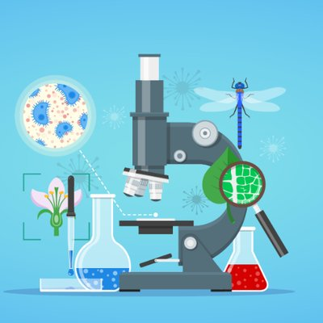
What is Biology?
Biology is a natural science that deals with the study of living organisms. It came from the Greek word bios, which means “life” and logia, which means “study of”. Hence it is called the science of life.

Slide 3
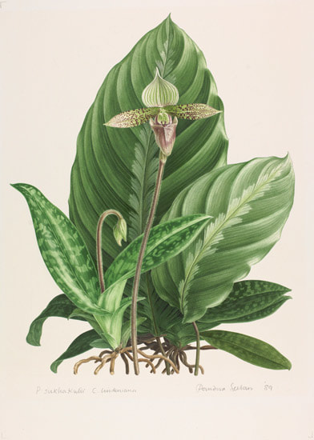

Biology is also categorized based on the type of organism being studied.

Slide 4
About the historical development of biology

Slide 5
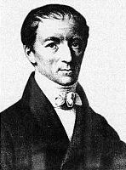
Gottfried Reinlod Treviranus
He was a German naturalist and a proponent of the Theory of the Transmutation of Species, a theory of evolution held by some biologists prior to the work of Charles Darwin.

Slide 6
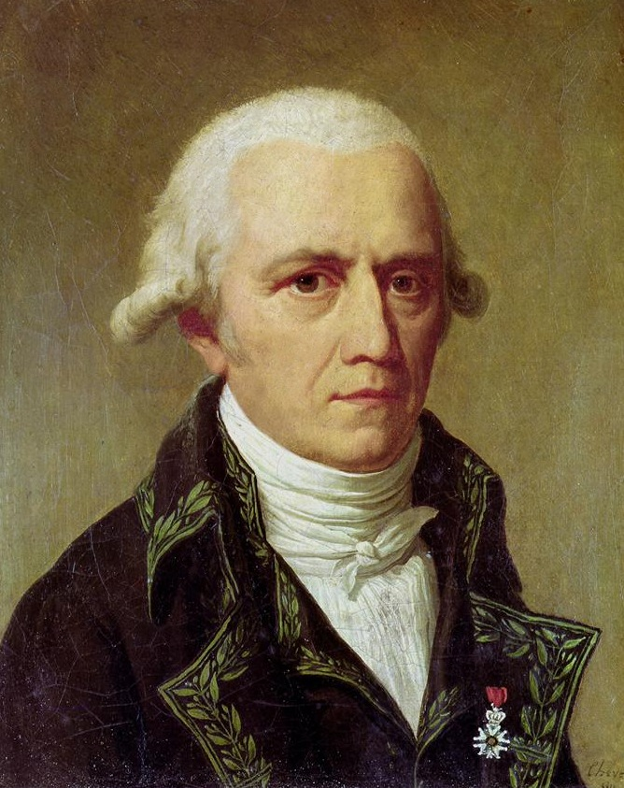
Jean-Baptiste Lamarck
He was a French naturalist and an early proponent of the idea that evolution occurred and proceeded in accordance with natural laws.

Slide 7
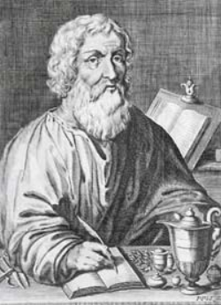
Hippocrates of Cos
Referred as the Father of Western Medicine in recognition of his lasting contributions to the field as the founder of the Hippocratic School of Medicine, thus establishing medicine as a profession.

Slide 8
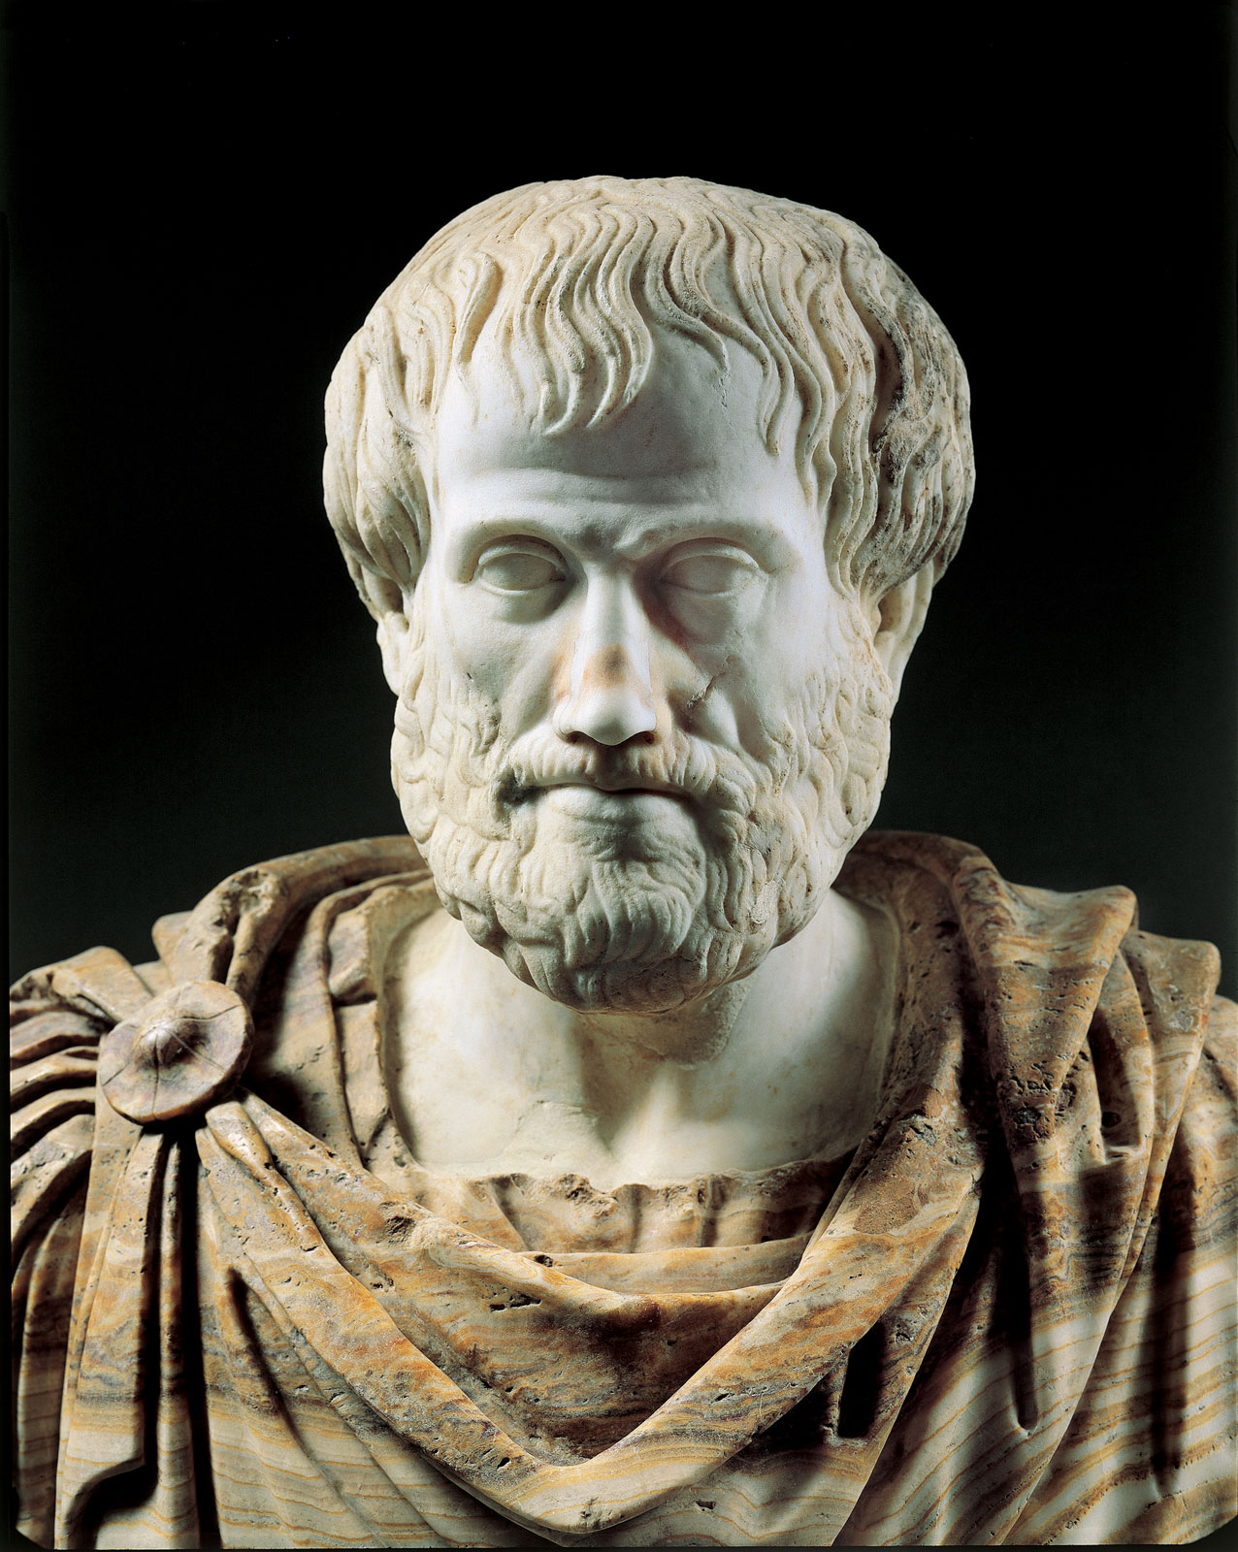
Aristotle
He was a Greek philosopher, a student of Plato and teacher of Alexander the Great. His writings cover many subjects, including physics, metaphysics, poetry, theater, music, logic, rhetoric, politics, etc..

Slide 9
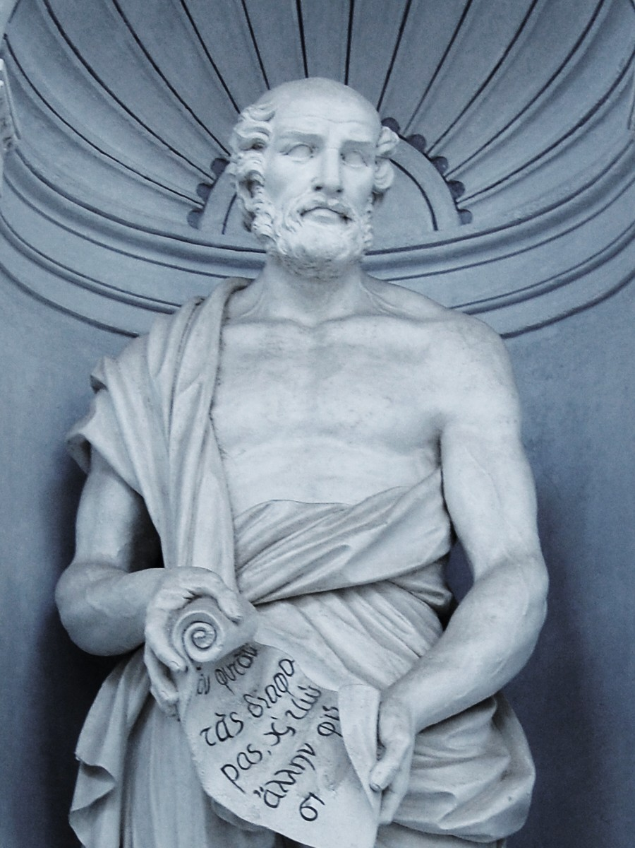
Theophrastus
Successor of Aristotle in the Peripatetic school. His two surviving botanical works, “Enquiry into Plants” and “On the Causes of Plants,” were an important influence on medieval science.

Slide 10
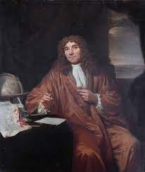
Antonie Philips van Leeuwenhoek
Commonly known as the Father of Microbiology, and considered to be the first microbiologist.

Slide 11
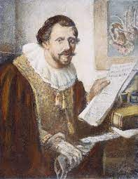
Jan Swammerdam
He was a Dutch biologist and microscopist. His work on insects demonstrated that the various phases during the life of an insect.

Slide 12
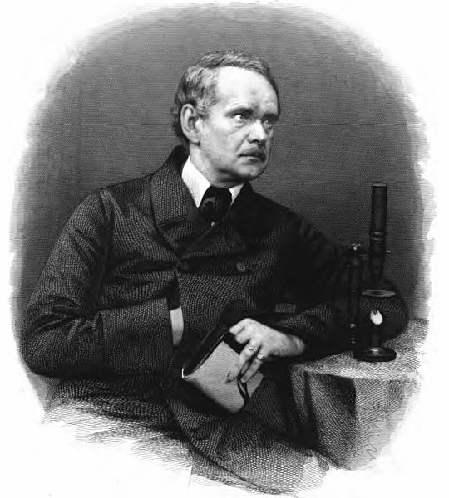
Matthias Jakob Schleiden
He was a German botanist and co-founder of the cell theory, along with Theodor Schwann and Rudolf Virchow.

Slide 13
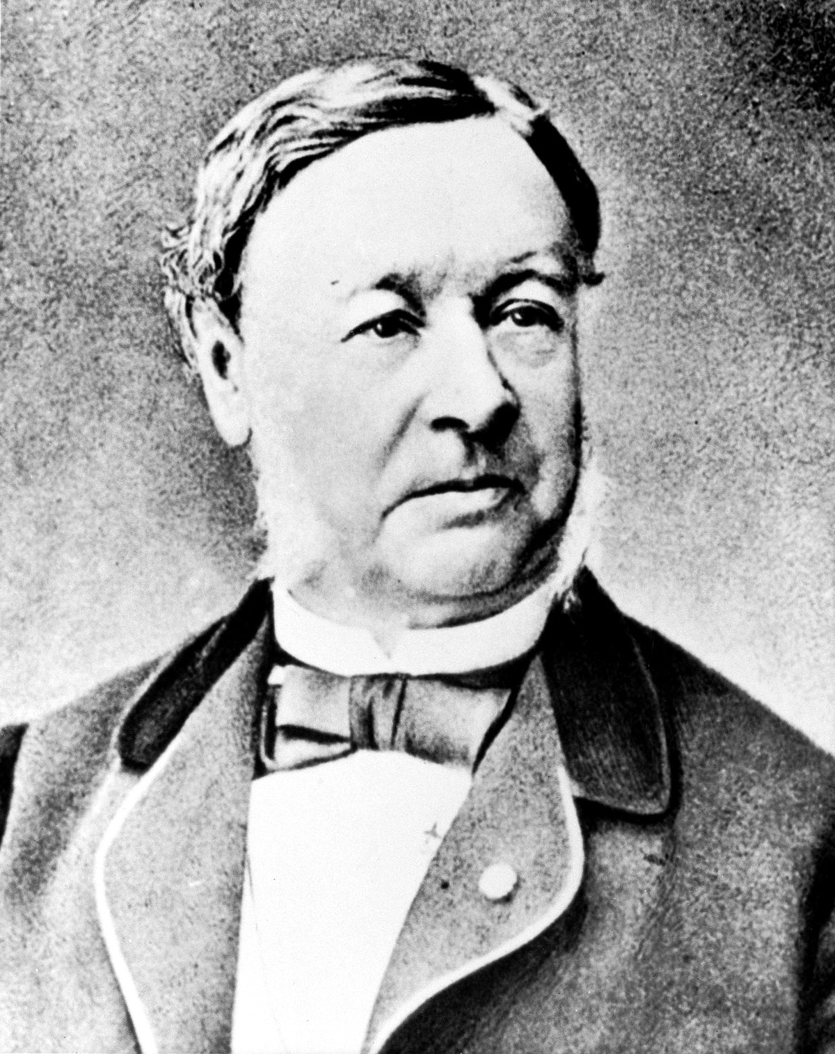
Theodor Schwann
He was a German physiologist. His many contributions to biology include the development of cell theory, the discovery of Schwann cells in the peripheral nervous system, the organic nature of yeast, and the invention of the term metabolism.

Slide 14
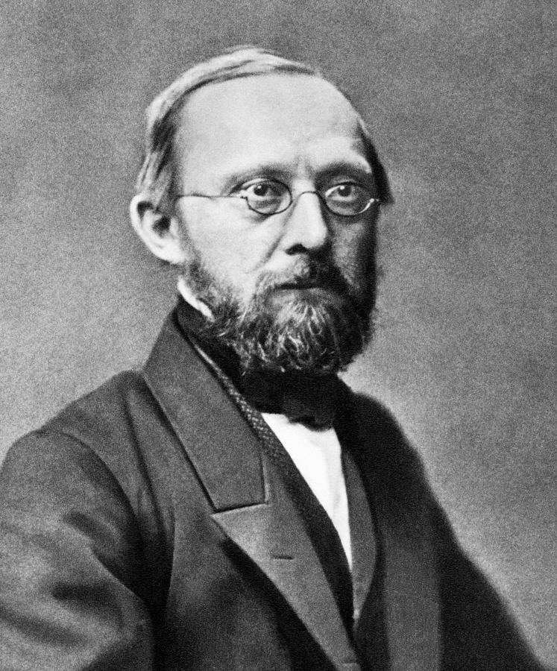
Rudolf Ludwig Karl Virchow
He was a German doctor, anthropologist, pathologist, prehistorian, biologist, and politician, known for his advancement of public health.

Slide 15
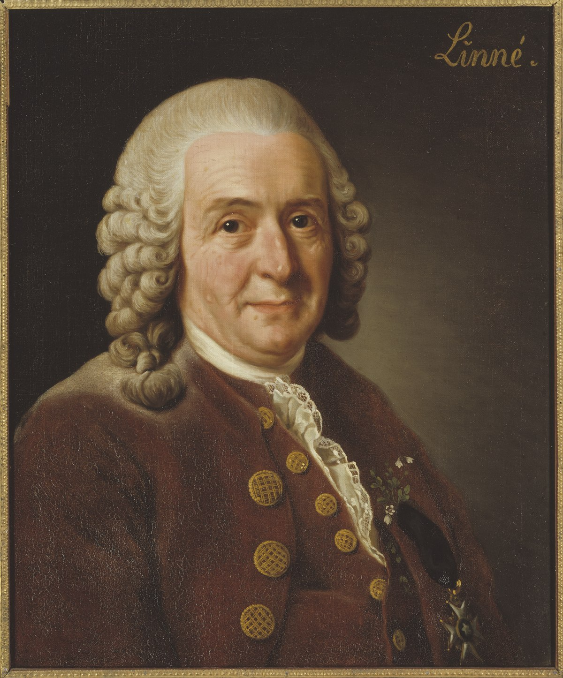
Carl Linnaeus
He was a Swedish botanist, physician, and zoologist, who laid the foundations for the modern scheme of binomial nomenclature.

Slide 16
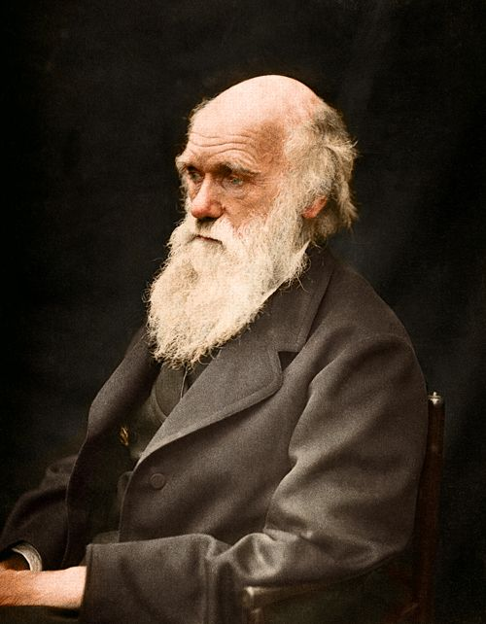
Charles Robert Darwin
He was an English naturalist who established that all species of life have descended over time from common ancestry, and proposed the scientific theory that this branching pattern of evolution resulted from a process that he called natural selection.

Slide 17
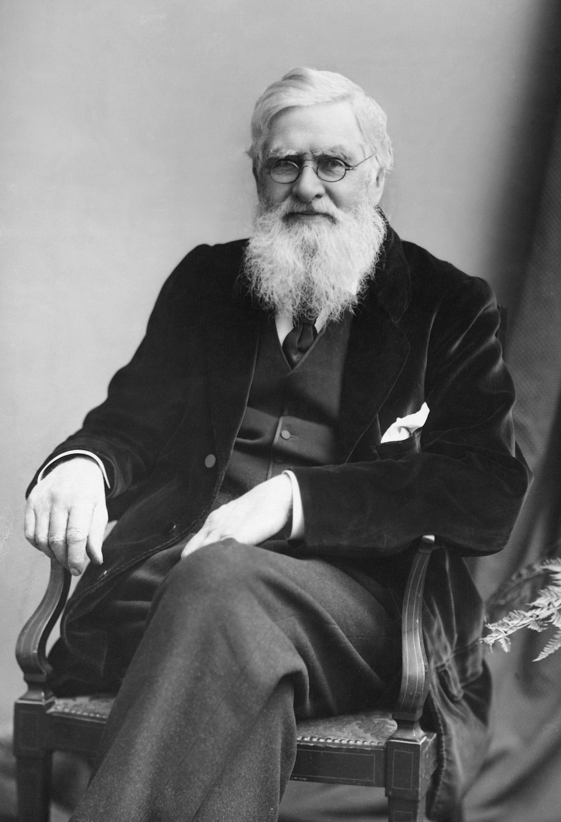
Alfred Russel Wallace
He was a British naturalist, explorer, geographer, anthropologist, and biologist.

